Slide 1
RESOURCE TRACKING WEBINAR
March 18, 2020
Funders Concerned About AIDS

Slide 2
LOGISTICS
We are recording this webinar
Mute your lines please!
Q & A
Chat questions or
Email to Sarah@fcaaids.org

Slide 3
AGENDA
Philanthropic Support to Address HIV/AIDS, 2018: Cat Gironda, FCAA
Putting Data into Action: Arben Fetai, Aidsfonds Kanna Dharmarajah, Frontline AIDS
Refresh: How to Submit Data
Looking Forward with FCAA: John Barnes, FCAA

Slide 4
Overview: 2018 report

Slide 5
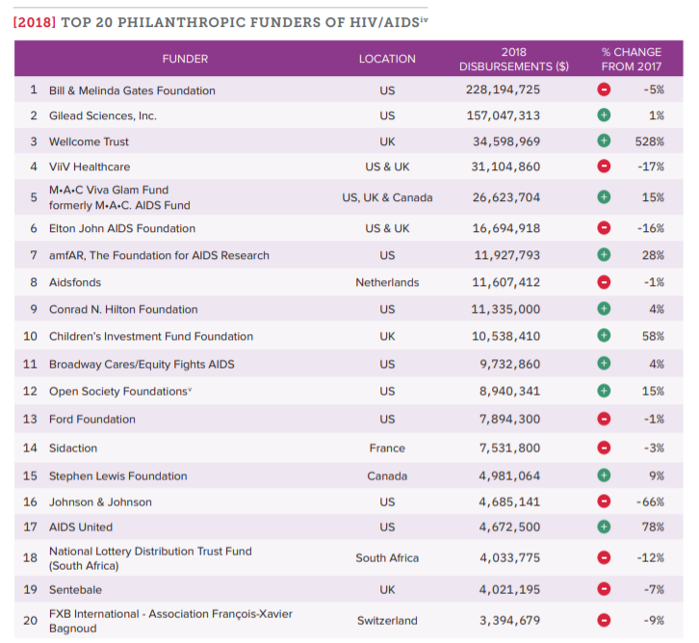
A Concentration at the Top

Slide 6
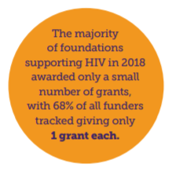
Increased Data Collection

Slide 7
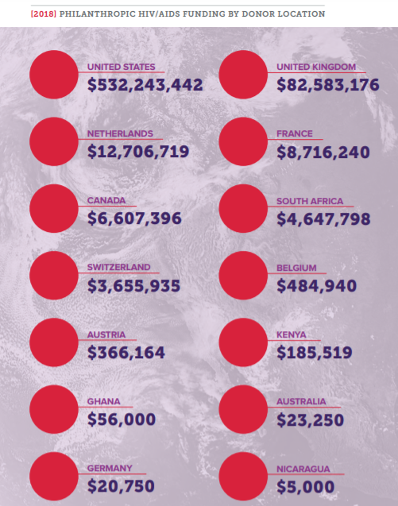
Where’s Funding Coming from?
14 different countries
Majority of funding originates in US
30 corporate funders, account for 34% of all funding

Slide 8
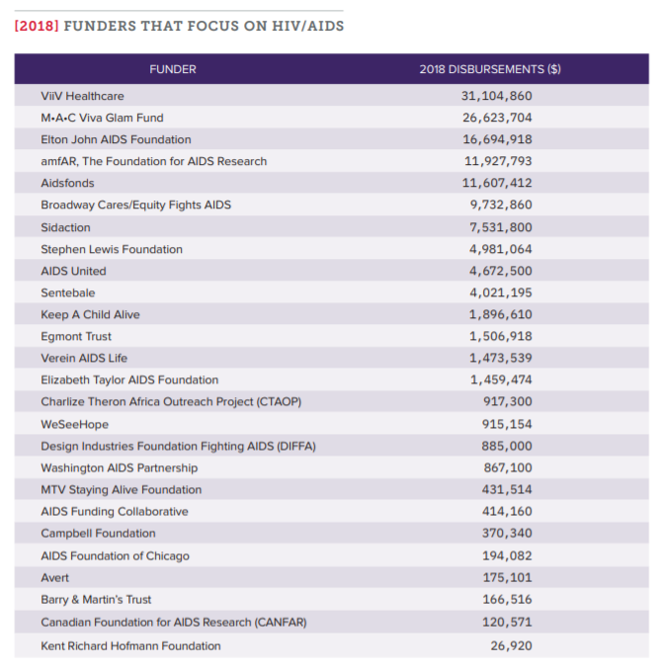
Where’s Funding Coming from?

Slide 9
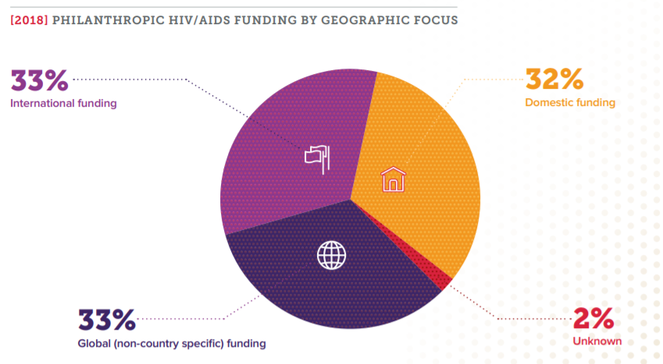
Where’s Funding Going?

Slide 10
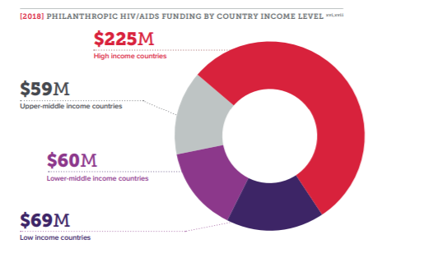
Where’s Funding Going?

Slide 11
Where’s Funding Going?

Slide 12
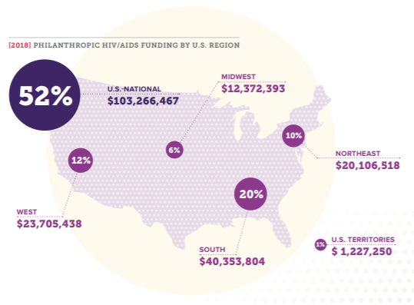
A Look at the United States

Slide 13
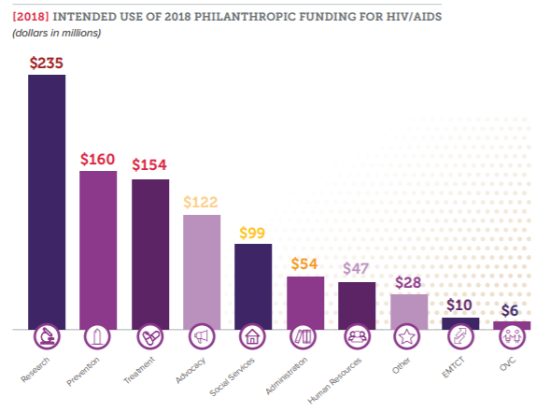
Funding the Right Strategies

Slide 14
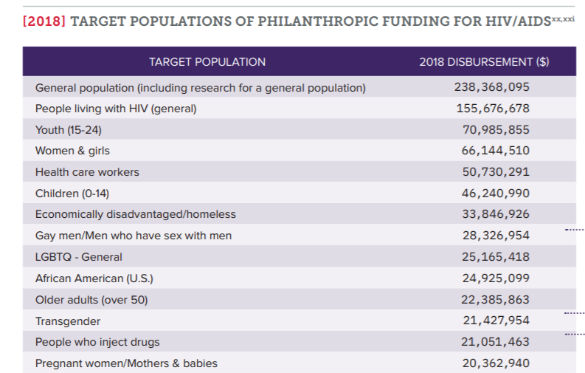
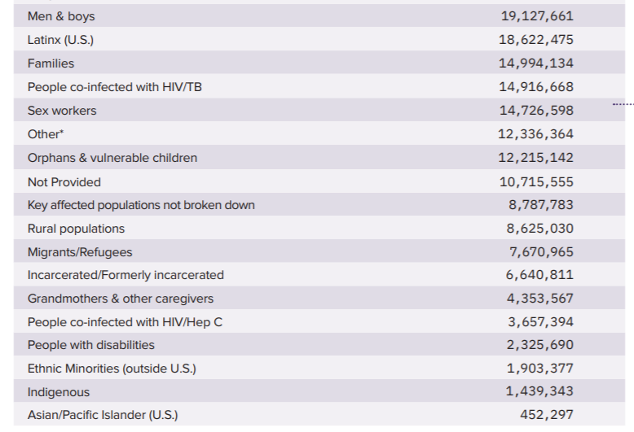
Who is the Funding Reaching?

Slide 15
Funding Context

Slide 16
Putting Data into Action: Key Population Desk Review
Arben Fetai, Aidsfonds
Kanna Dharmarajah, Frontline AIDS

Slide 17
“Off-track”: How Global Investments in HIV Programming for Key Populations are Falling Short (working title)

Slide 18
First-ever analysis of global investments in HIV programming for men who have sex with men, trans people, sex workers and people who use drugs, looking at the gap between the aspirations of the collective goals set through the Fast-Track strategy and the reality of resource mobilisation in LMICs.
Based on data for 2016-2018, the report will provide the most comprehensive mapping to date on funding for key populations, looking at investments made by the major funders of the global HIV response: LMICs governments, PEPFAR, the Global Fund, other donor governments and private philanthropy (FCAA & Global Philanthropy Project data).
Will be launched in July 2020 aiming to provide an advocacy tool for addressing the funding and data gaps regarding key populations.

Slide 19
Refresh: How to Submit Data

Slide 20
Funding at the Intersections: What does it mean to be an HIV Funder?
John Barnes, FCAA

Slide 21
What to Look Forward to this Year!
April
Call for Data Launches & FCAA Spring Membership Drive begins
5 July
FCAA submitted session at HIV2020 - pending
7 July
FCAA Funder Reception at AIDS2020
July
New data from FCAA on GGR gagged grantees!
August
Data collection ends!
16–17 Nov.
DC: FCAA’s AIDS Philanthropy Summit!
Call for Sessions for FCAA AIDS Philanthropy Summit
May

Slide 22
Questions?

